Slide 1
Commerce Notifications
Group 2
Kory, Matt, Jimin, Connor
Notes:
Name
Graduation date
Prior experience
Personal goals for the project

Slide 2
Project Details
The application must be web based
The application should be functional across multiple devices
The application frontend should be created with some modern framework
The application should show users the transactions they have on their account
The application should allow users to set custom notifications for new transactions
Notes:
Kory

Slide 3
Requirements
Notifications Page:
Shows notification rules set by the user
Show the number of times a notification rule has been triggered
Allows users to add/edit/remove their rules
Allows user to set filters to view their notifications
Ability to export notifications to a spreadsheet
Transactions Page
Show users a table of their transactions
Allow user to add transactions
Notes:
Connor

Slide 4


Technology Stack: Client Side
Angular web framework
Open Source
Type-Script based
Ng-Bootstrap
Combines Angular and Bootstrap’s CSS elements
Reduces the bloat of regular Bootstrap by removing its dependency of J-Query
Notes:
Kory
For the project we decided to use the Angular web framework.
Chosen because some team members have more experience with it than other frameworks
For CSS styling we are using Ng-Bootstrap, which is a more lightweight version of bootstrap that is used within angular.

Slide 5


Technology Stack: Server Side
Springboot
Java based framework for creating microservices
Helpful for using RESTful web services
MySQL
Relational database management system
Notes:
Connor

Slide 6
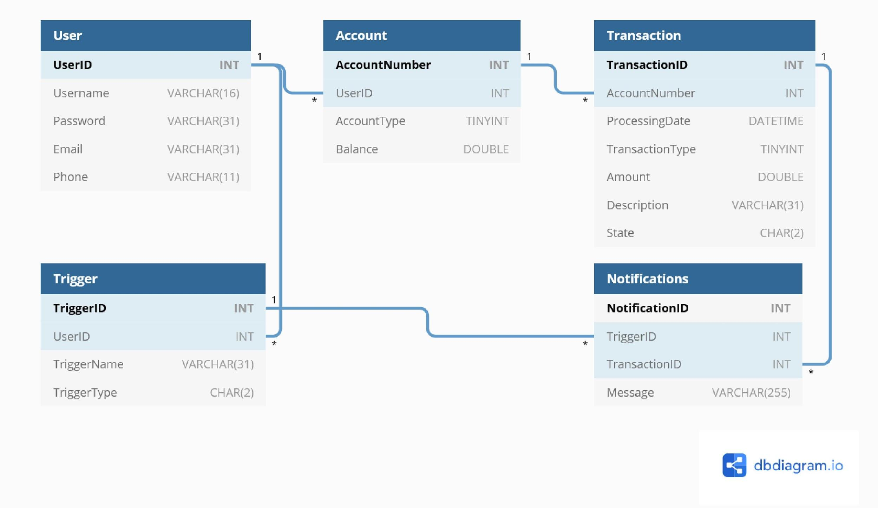
Entity Relationship Diagram
Notes:
Kory
User accounts that contain username password and optional email and phone numbers that are created with a unique ID
User accounts are tied to one or more accounts, which store an account number, the user that owns the account, an account type (checking/savings), and a balance.
These accounts have multiple transactions tied to them which consist of a transactionID, the account the transaction relates to, processing date, transaction type (deposit/withdrawal), the amount of the transaction, a description and the state it was done in
On the notifications side, a user can have many Notification triggers tied to their user account. These are maintained within a trigger table which contains the information needed to handle the SQL Triggers.
These triggers are tied to multiple notifications that are created when a new transaction triggers them. Notifications have a message and a transaction ID tied to them so that they can be related to a transaction.

Slide 7
Use Cases
Notes:
Matt

Slide 8
Use Case #1:
Customer Logs In
Basic Path
User logs into application
User clicks “Transactions” tab in the navigation bar
System loads the users transactions
User can view the transactions made on their account
User logs out
System exits
Alternate Path
User enters incorrect login information
System prompts user “Login information is incorrect” and asks user to re enter information
User enters correct information and follows basic path
Notes:
The first thing the user will do

Slide 9
Use Case #2:
Customer Checks Notifications
Basic Path
User logs in to application
The notifications dashboard is loaded
User can can choose which notification are active and the date range
User will see all transactions that trigger notifications rules
User may add, edit, or delete notifications rules
User may export notifications table to excel
User logs out
System exits
Alternate Path
User enters incorrect login information
System prompts user “Login information is incorrect” and asks user to re enter information
User enters correct information and follows basic path
Notes:
Matt

Slide 10
Use Case #3:
Customer Adds Transaction Which Triggers Notification
Basic Path
User logs into application
Clicks Transaction tab
User clicks “Add Transaction” button
Form generates for user:
User checks box for deposit or withdrawal
User enters amount
User enters description
User clicks “Add” button within popup
System takes user inputted values and combines with
User’s account number
The date of the transaction
System send new transaction to SQL through server
SQL database enters new transaction into table
Balance is incremented if transaction is deposit
Balance is decremented if transaction is withdrawal
User will see transaction added to their transaction log
If added transaction triggers notification user will be able to see notification in notification tab
User Clicks Log Out
System Exits
Alternative Path
User logs into application
User logs into application
Clicks Transaction tab
User clicks “Add Transaction” button
Form generates for user:
User checks box for deposit or withdrawal
User enters amount
User enters description
User clicks “Cancel” button within popup
User Clicks Log Out
System Exits
Notes:
Created to demo application

Slide 11
Future Implementations
Notes:
Jimin

Slide 12
Securing a Web Application
This Process of making a simple web application with properties that are protected by Spring Security.
We make a Spring MVC application that secures the page with a login page that is backed by a fixed list of users.
Notes:
Jimin

Slide 13
Spring Security
Spring Security is the extremely customizable authentication and access-control framework.
The main concentration of spring security is on Authentication and Authorization.
Where authentication is the process of establishing a principal (user)
who claim to be.
Where authorization is the process of deciding whether the logged in principal (user) allowed to perform a certain actions.
Classes: AuthenticationTokenFilter, CsrfHeaderFilter, JwtUser, JwtTokenUtil, Jwt_Authentication_Entry_Point.
Notes:
Jimin

Slide 14
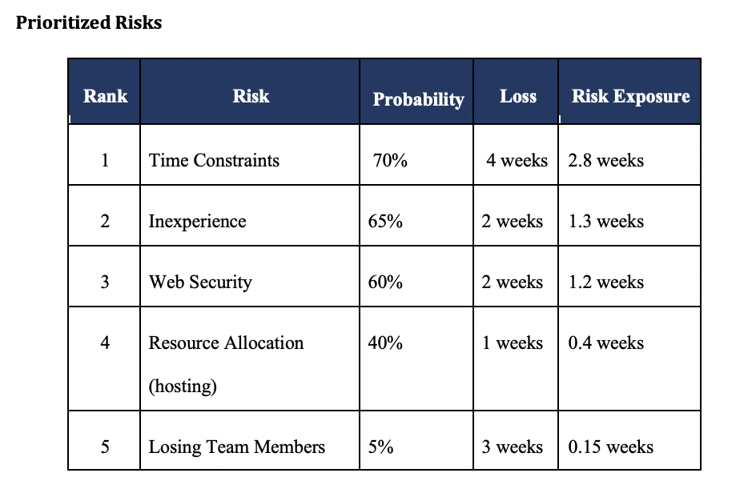
Some Potential Risks
Notes:
Connor

Slide 15
Initial Prototype Demo

